Slide 1

PRODUCT RECOMMENDATION SYSTEM USING ML TECHNIQUES
Date: 15 April 2021
T.HARIPRIYA:17WH1A0585
M.SRAVANTHI: 18WH5A0512
M.MEGHANA:17WH1A05B1
Internal Guide: Mr. C.Naga Raju Designation: Assistant Professor
Department of Computer Science & Engineering
BVRIT HYDERABAD College of Engineering for Women

Slide 2

Why Should I Study this course?
ABSTRACT
In this project, we design product recommendation engine that uses collaborative filtering approach, which finds similarity between items bought by the customers with other customers, purchase pattern, and association rule mining framework.
The recommendations were generated in order to facilitate ‘cross-sell’ across various items. The collaborative filtering (CF) approach produced the top 10 recommendations for each user.
Collaborative filtering based recommendation engine. Has 2 variants, user-based collaborative filtering and item-based collaborative filtering.
There are numerous ways such as collaborative filtering, content-based filtering, hybrid filtering, etc. to build a recommendation system
Examples
BVRIT HYDERABAD College of Engineering for Women

Slide 3
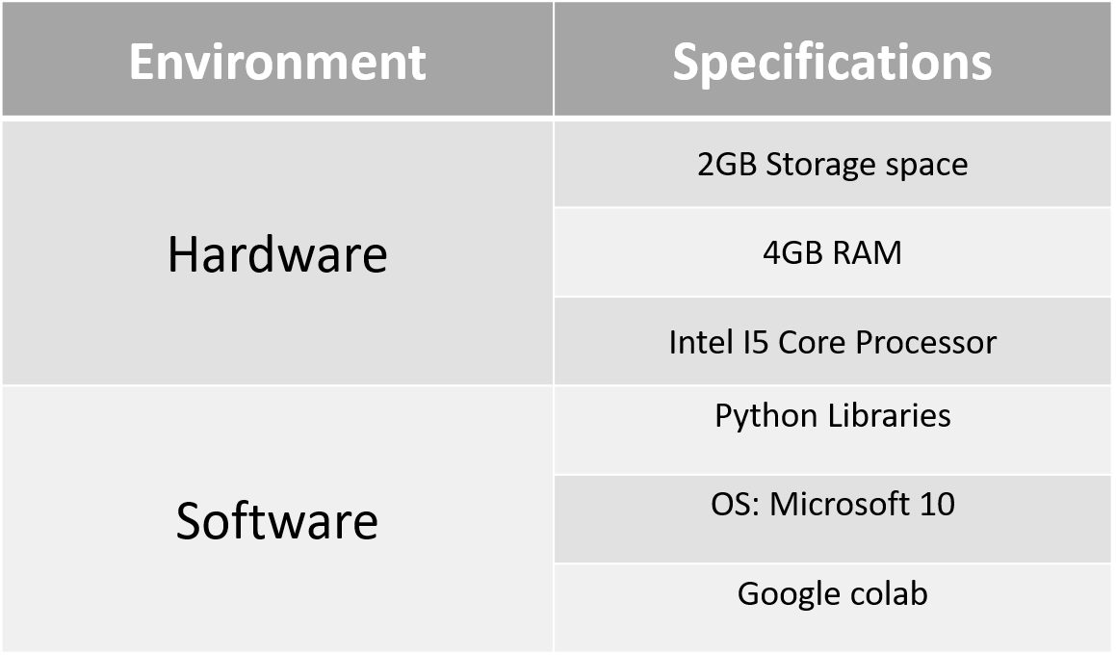
Why Should I Study this course?
System Requirements
Examples
BVRIT HYDERABAD College of Engineering for Women

Slide 4
Why Should I Study this course?
Timeline
Review | Excepted Completion
Review 0 | Requirements Specification Base paper and references
Review 1 | Data preprocessing Sentimental Analysis
Review 2 | Complete Implementation Report for the Project
Examples
BVRIT HYDERABAD College of Engineering for Women

Slide 5
Why Should I Study this course?
References
Mohana,Ayush Jain-Development of Product Recommendation Engine By Collaborative Filtering and Association Rule Mining Using Machine Learning Algorithms,2020(Base-Paper)
BardulSarwar et.al., “Item-based Collaborative Filtering Recommendation Algorithms”, in proceedings of the 10th International Conference on World Wide Web, Hong Kong, pp. 285-295, 2001.
Ya-Yueh Shih et all., “Product Recommendation Approaches: Collaborative Filtering via Customer Lifetime Value and Customer Demands”, Journal of Expert Systems, vol.35(1), pp. 350-360, 2008.
F.O. Isinkaye et.al., “Recommendation Systems: Principles, Methods and evaluation”, Journal of Egyptian Informatics, vol. 16(3), pp. 261- 273, August 2015.
Masupha Lerato et.al., “A Survey of Recommender System Feedback Techniques, Comparison and Evaluation Metrics”, in proceedings of IEEE International Conference on Computing, Communication and Security, Mauritius, pp.1-4, December 2015.
https://www.kaggle.com/skillsmuggler/amazon-ratings(Datasets from kaggle).
Examples
BVRIT HYDERABAD College of Engineering for Women

Slide 6
Thankyou
BVRIT HYDERABAD College of Engineering for Women

